Slide 1
Supply, Demand, and Government Policies
CHAPTER 6
Notes:
N. Gregory Mankiw Principles Of Economics Eight Edition

Slide 2
Controls on Prices, Part 1
Price controls
Policymakers believe that the market price of a good or service is unfair to buyers or sellers
Can generate inequities
Taxes
To raise revenue for public purposes
To influence market outcomes

Slide 3
Controls on Prices, Part 2
Price ceiling
A legal maximum on the price at which a good can be sold
Rent-control laws
Price floor
A legal minimum on the price at which a good can be sold
Minimum wage laws

Slide 4
Controls on Prices, Part 3
How price ceilings affect market outcomes
Not binding
Set above the equilibrium price
No effect on the price or quantity sold
Binding constraint
Set below the equilibrium price: Shortage
Sellers must ration the scarce goods
Rationing mechanisms: long lines, discrimination according to sellers bias

Slide 5
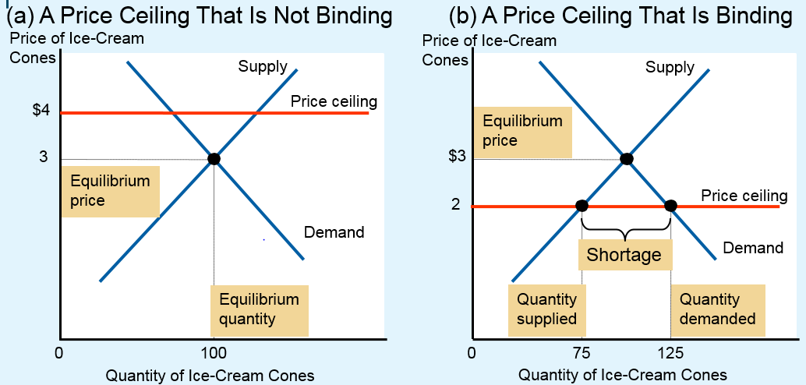
Figure 1 A Market with a Price Ceiling
In panel (a), the government imposes a price ceiling of $4. Because the price ceiling is above the equilibrium price of $3, the price ceiling has no effect, and the market can reach the equilibrium of supply and demand. In this equilibrium, quantity supplied and quantity demanded both equal 100 cones.
In panel (b), the government imposes a price ceiling of $2. Because the price ceiling is below the equilibrium price of $3, the market price equals $2. At this price, 125 cones are demanded and only 75 are supplied, so there is a shortage of 50 cones.

Slide 6
Lines at the gas pump, Part 1
1973, OPEC raised the price of crude oil
Reduced the supply of gasoline
Long lines at gas stations
What was responsible for the long gas lines?
OPEC
Shortage of gasoline
U.S. government regulations
Price ceiling on gasoline

Slide 7
Lines at the gas pump, Part 2
Price ceiling on gasoline
Before OPEC raised the price of crude oil
Equilibrium price was below the price ceiling
No effect on the market
When the price of crude oil rose
Decrease in the supply of gasoline
Equilibrium price was above the price ceiling
Binding price ceiling: Severe shortage
Laws regulating the price of gasoline were repealed

Slide 8
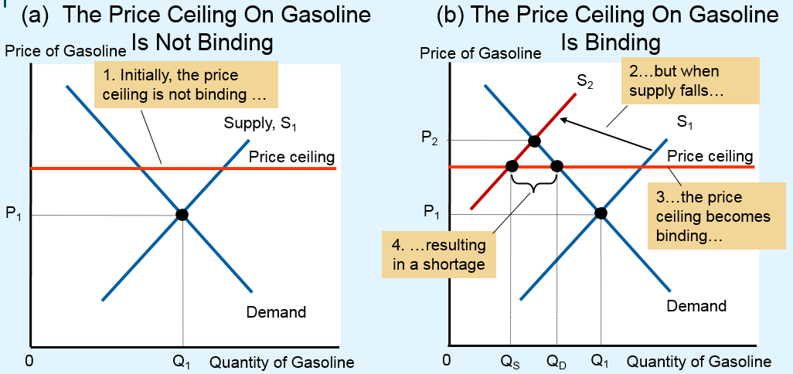
Figure 2 The Market for Gasoline with a Price Ceiling
Panel (a) shows the gasoline market when the price ceiling is not binding because the equilibrium price, P₁, is below the ceiling. Panel (b) shows the gasoline market after an increase in the price of crude oil (an input into making gasoline) shifts the supply curve to the left from S₁ to S₂. In an unregulated market, the price would have risen from P₁ to P₂. The price ceiling, however, prevents this from happening. At the binding price ceiling, consumers are willing to buy Q_{D}, but producers of gasoline are willing to sell only Q_{S}. The difference between quantity demanded and quantity supplied, Q_{D} – Q_{S}, measures the gasoline shortage.

Slide 9
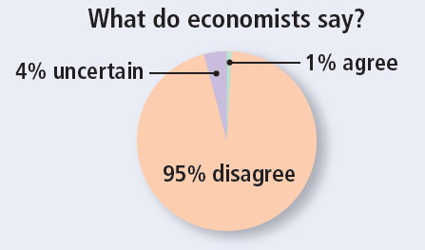
ASK THE EXPERTS, Part 1
Rent Control
“Local ordinances that limit rent increases for some rental housing units, such as in New York and San Francisco, have had a positive impact over the past three decades on the amount and quality of broadly affordable rental housing in cities that have used them.”

Slide 10
Rent control in the short run and the long run, Part 1
Price ceiling: rent control
Local government places a ceiling on rents
Goal: to help the poor
Making housing more affordable
Critique
Highly inefficient way to help the poor raise their standard of living

Slide 11
Rent control in the short run and the long run, Part 2
Adverse effects in the short run
Supply and demand for housing are inelastic in the short run
Small shortage
Reduced rents

Slide 12
Rent control in the short run and the long run, Part 3
Adverse effects in the long run
Supply and demand are more elastic
Landlords
Are not building new apartments
Are failing to maintain existing ones
People
Find their own apartments
Induce more people to move into a city
Large shortage of housing

Slide 13
Rent control in the short run and the long run, Part 4
Adverse effects in the long run
Rationing mechanisms
Long waiting lists
Preference to tenants without children
Discriminate on the basis of race
Bribes to building superintendents
People respond to incentives
Free markets
Landlords – clean and safe buildings
Higher prices

Slide 14
Rent control in the short run and the long run, Part 5
People respond to incentives
Rent control
Shortages and waiting lists
Landlords lose their incentive to respond to tenants’ concerns
Tenants get lower rents and lower-quality housing
Policymakers – additional regulations
Difficult and costly to enforce

Slide 15
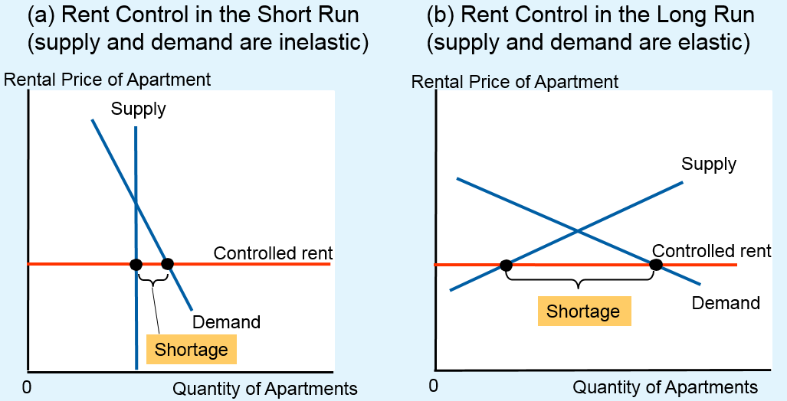
Figure 3 Rent Control in Short Run and in Long Run
Panel (a) shows the short-run effects of rent control: Because the supply and demand curves for apartments are relatively inelastic, the price ceiling imposed by a rent-control law causes only a small shortage of housing.
Panel (b) shows the long-run effects of rent control: Because the supply and demand curves for apartments are more elastic, rent control causes a large shortage.

Slide 16
Controls on Prices, Part 4
How price floors affect market outcomes
Not binding
Set below the equilibrium price
No effect on the market
Binding constraint
Set above the equilibrium price: Surplus
Some sellers are unable to sell what they want
Rationing mechanisms: not desirable

Slide 17
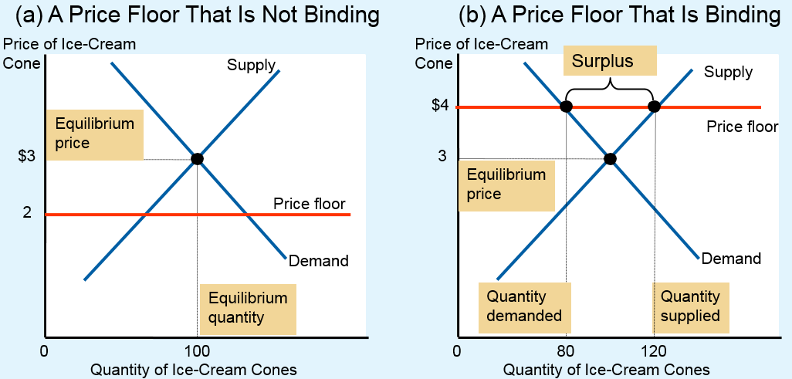
Figure 4 A Market with a Price Floor
In panel (a), the government imposes a price floor of $2. Because this is below the equilibrium price of $3, the price floor has no effect. The market price adjusts to balance supply and demand. At the equilibrium, quantity supplied and quantity demanded both equal 100 cones.
In panel (b), the government imposes a price floor of $4, which is above the equilibrium price of $3. Therefore, the market price equals $4. Because 120 cones are supplied at this price and only 80 are demanded, there is a surplus of 40 cones.

Slide 18
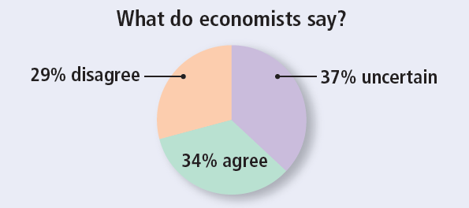
ASK THE EXPERTS, Part 2
The Minimum Wage
“If the federal minimum wage is raised gradually to $15-per-hour by 2020, the employment rate for low-wage U.S. workers will be substantially lower than it would be under the status quo.”

Slide 19
The minimum wage, Part 1
Price floor: minimum wage
Lowest price for labor that any employer may pay
Fair Labor Standards Act of 1938
Ensures workers a minimally adequate standard of living
2015, federal minimum wage, $7.25/hour
Some states mandate minimum wages above the federal level

Slide 20
The minimum wage, Part 2
France
Average income is 30% lower than in the U.S.
Minimum wage is more than 30% higher
Market for labor
Workers supply labor
Firms demand labor

Slide 21
The minimum wage, Part 3
If minimum wage is above equilibrium
Unemployment
Higher income for workers who have jobs
Lower income for workers who cannot find jobs
Impact of the minimum wage on highly skilled and experienced workers
No effect: their equilibrium wages are well above the minimum
Minimum wage: not binding

Slide 22
The minimum wage, Part 4
Impact of the minimum wage on teenage labor
Least skilled and least experienced
Low equilibrium wages
Willing to accept a lower wage in exchange for on-the-job training
Minimum wage: binding

Slide 23
The minimum wage, Part 5
Teenage labor market
A 10% increase in the minimum wage depresses teenage employment between 1 and 3%
Some teenagers who are still attending high school choose to drop out and take jobs
Displace other teenagers who had already dropped out of school and who now become unemployed

Slide 24
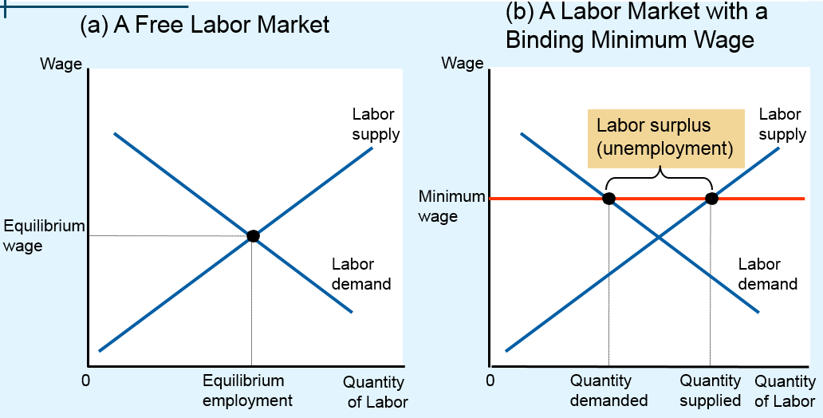
Figure 5 How Minimum Wage Affects Labor Market
Panel (a) shows a labor market in which the wage adjusts to balance labor supply and labor demand.
Panel (b) shows the impact of a binding minimum wage. Because the minimum wage is a price floor, it causes a surplus: The quantity of labor supplied exceeds the quantity demanded. The result is unemployment.

Slide 25
The minimum wage, Part 6
Advocates of the minimum wage
Raise the income of the working poor
Workers who earn the minimum wage can afford only a meager standard of living
Opponents of the minimum wage
Not the best way to combat poverty
Unemployment, encourages teenagers to drop out of school, prevents some unskilled workers from getting on-the-job training
Poorly targeted policy

Slide 26
Evaluating Price Controls, Part 1
Markets are usually a good way to organize economic activity
Economists usually oppose price ceilings and price floors
Prices are not the outcome of some haphazard process
Prices have the crucial job of balancing supply and demand
Coordinating economic activity

Slide 27
Evaluating Price Controls, Part 2
Governments can sometimes improve market outcomes
Want to use price controls
Because of unfair market outcome
Aimed at helping the poor
Often hurt those they are trying to help
Other ways of helping those in need
Rent subsidies
Wage subsidies (earned income tax credit)

Slide 28
Taxes, Part 1
Government uses taxes
To raise revenue for public projects
Roads, schools, and national defense
Tax incidence
Manner in which the burden of a tax is shared among participants in a market

Slide 29
Taxes, Part 2
How taxes on sellers affect market outcomes
Immediate impact on sellers: shift in supply
Supply curve shifts left
Higher equilibrium price
Lower equilibrium quantity
The tax reduces the size of the market

Slide 30
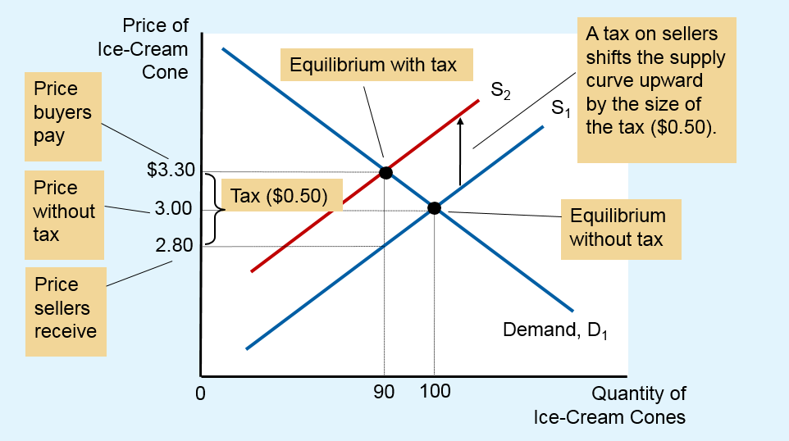
Figure 6 A Tax on Sellers
When a tax of $0.50 is levied on sellers, the supply curve shifts up by $0.50 from S₁ to S₂. The equilibrium quantity falls from 100 to 90 cones. The price that buyers pay rises from $3.00 to $3.30. The price that sellers receive (after paying the tax) falls from $3.00 to $2.80. Even though the tax is levied on sellers, buyers and sellers share the burden of the tax.

Slide 31
Taxes, Part 3
How taxes on sellers affect market outcomes
Taxes discourage market activity
Buyers and sellers share the burden of tax
Buyers pay more, are worse off
Sellers receive less, are worse off
Get the higher price but pay the tax
Overall: effective price fall

Slide 32
Taxes, Part 4
How taxes on buyers affect market outcomes
Initial impact on the demand
Demand curve shifts left
Lower equilibrium price
Lower equilibrium quantity
The tax reduces the size of the market

Slide 33
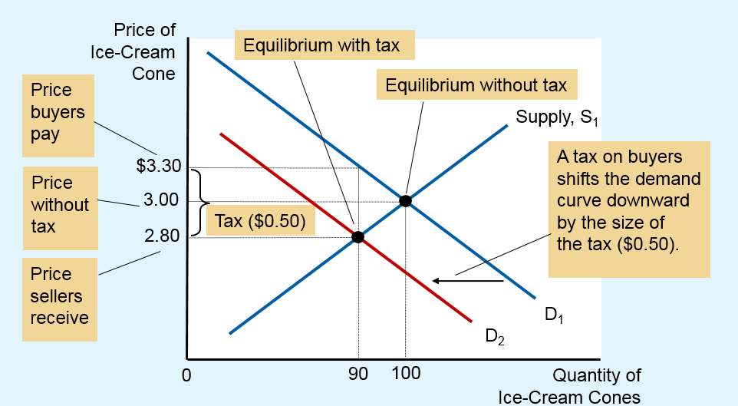
Figure 7 A Tax on Buyers
When a tax of $0.50 is levied on buyers, the demand curve shifts down by $0.50 from D₁ to D₂. The equilibrium quantity falls from 100 to 90 cones. The price that sellers receive falls from $3.00 to $2.80. The price that buyers pay (including the tax) rises from $3.00 to $3.30. Even though the tax is levied on buyers, buyers and sellers share the burden of the tax.

Slide 34
Taxes, Part 5
How taxes on buyers affect market outcomes
Buyers and sellers share the burden of tax
Sellers get a lower price, are worse off
Buyers pay a lower market price, are worse off
Effective price (with tax) rises

Slide 35
Taxes, Part 6
Taxes levied on sellers and taxes levied on buyers are equivalent
Wedge between the price that buyers pay and the price that sellers receive
The same, regardless of whether the tax is levied on buyers or sellers
Shifts the relative position of the supply and demand curves
Buyers and sellers share the tax burden

Slide 36
Can Congress distribute the burden of a payroll tax?, Part 1
Payroll taxes
Deducted from the amount you earned
By law, the tax burden:
Half of the tax is paid by firms
Out of firm’s revenue
Half of the tax is paid by workers
Deducted from workers’ paychecks

Slide 37
Can Congress distribute the burden of a payroll tax?, Part 2
Tax incidence analysis
Payroll tax as a tax on a good
The good is labor
The price is the wage
Introduce payroll tax
Wage received by workers falls
Wage paid by firms rises
Workers and firms share the tax burden
Not necessarily 50 – 50 as required

Slide 38
Can Congress distribute the burden of a payroll tax?, Part 3
Lawmakers
Can decide whether a tax comes from the buyer’s pocket or from the seller’s
Cannot legislate the true burden of a tax
Tax incidence
Determined by the forces of supply and demand

Slide 39
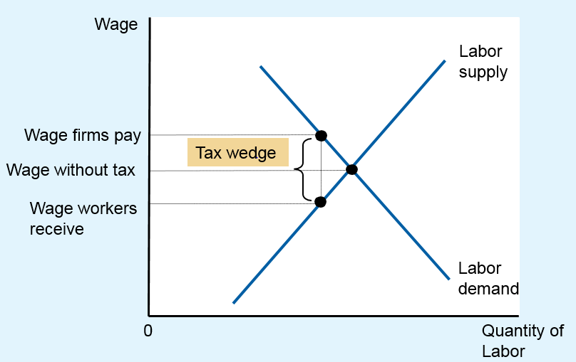
Figure 8 A Payroll Tax
A payroll tax places a wedge between the wage that workers receive and the wage that firms pay. Comparing wages with and without the tax, you can see that workers and firms share the tax burden. This division of the tax burden between workers and firms does not depend on whether the government levies the tax on workers, levies the tax on firms, or divides the tax equally between the two groups.

Slide 40
Taxes, Part 7
Elasticity and tax incidence
Very elastic supply and relatively inelastic demand
Sellers bear a small burden of tax
Buyers bear most of the burden
Relatively inelastic supply and very elastic demand
Sellers bear most of the tax burden
Buyers bear a small burden

Slide 41
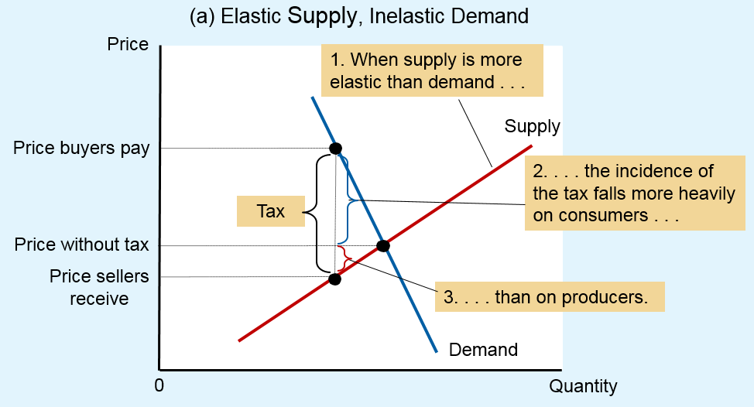
Figure 9 How the Burden of a Tax Is Divided, Part 1
In panel (a), the supply curve is elastic, and the demand curve is inelastic. In this case, the price received by sellers falls only slightly, while the price paid by buyers rises substantially. Thus, buyers bear most of the burden of the tax.

Slide 42
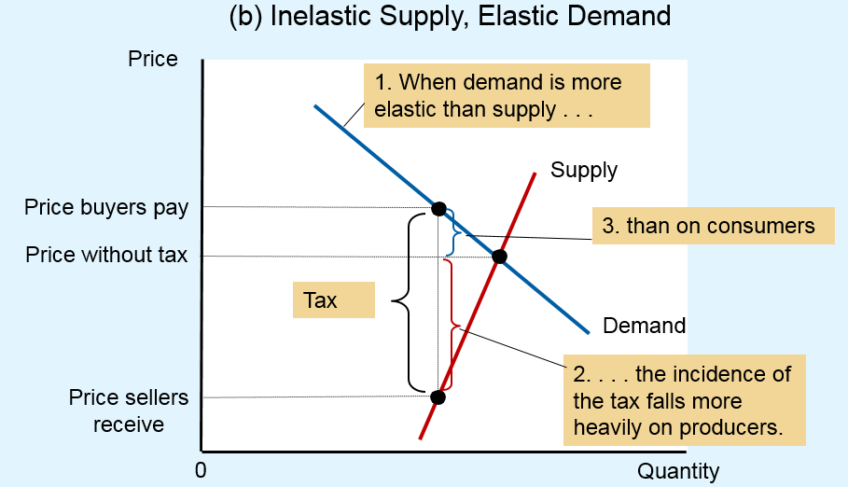
Figure 9 How the Burden of a Tax Is Divided, Part 2
In panel (b), the supply curve is inelastic, and the demand curve is elastic. In this case, the price received by sellers falls substantially, while the price paid by buyers rises only slightly. Thus, sellers bear most of the burden of the tax.

Slide 43
Taxes, Part 8
Tax burden
Falls more heavily on the side of the market that is less elastic
Small elasticity of demand
Buyers do not have good alternatives to consuming this good
Small elasticity of supply
Sellers do not have good alternatives to producing this good

Slide 44
Who pays the luxury tax?, Part 1
1990, Congress adopted a new luxury tax
On yachts, private airplanes, furs, jewelry, expensive cars
Goal: to raise revenue from those who could most easily afford to pay
Luxury items
Demand is quite elastic
Supply is relatively inelastic

Slide 45

Who pays the luxury tax?, Part 2
Outcome:
Burden of a tax falls largely on the suppliers
Relatively inelastic supply
1993: most of the luxury tax was repealed
“If this boat were any more expensive, we’d be playing golf.”

